Slide 1
Narrative Visualization:
Connecting Insights
JOUR479D/779D
University of Maryland
Nick Diakopoulos

Slide 2
On Narrative
Narratives have been used since ancient times to transfer knowledge and information over time. e.g. Homer, religious parable, folktales
Narratives are an information package that aid memory and recall by embedding info into characters, settings, relationships, and events.
Stories are the file format of human experience.

Slide 3
Narrative Definition
“an account of a series of events, facts, etc, given in order and with the establishing of connections between them.”
-Oxford English Dictionary

Slide 4
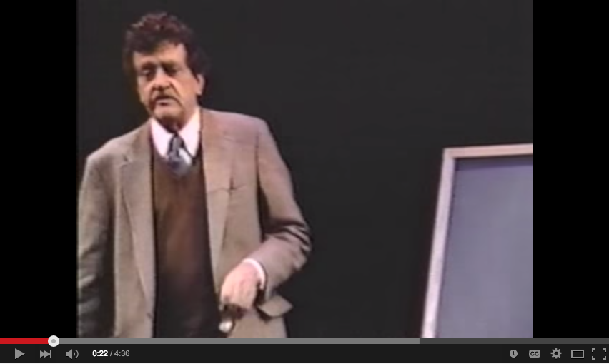
On Story Structure
Notes:
https://www.youtube.com/watch?v=oP3c1h8v2ZQ
It can be useful to think about abstractions that help structure a narrative into tension and relaxation.

Slide 5
Linear / Communicative
Author directed
Communicate conclusions
No interactivity
Freeform / Interactive / Exploratory
User directed (unordered)
No messaging
Free interactivity
Notes:
Structure can refer not only to plot but to the way in which the story is presented, and the degree of interactivity present.

Slide 6

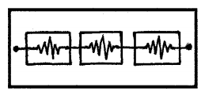
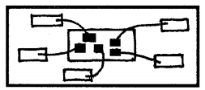
Story Structures
Martini Glass
Interactive Slideshow
Drill-Down Story
Notes:
Segel and Heer discuss different story structures that combine different forms of interactivity.
Martini glass structure: Initially stars with questions, observations, interesting default views and annotations. Then open up to reader-driven free interactivity. the author-driven narrative functioning first, then followed separately by the reader-driven interactions
Interactive Slideshow: Author advances story, but within each chunk you can have some interactivity. This structure allows the user to further explore particular points of the presentation before moving ahead to the next stage of the story.
Drill-down story: presents a general theme and then allows the user to choose among particular instances of that theme to reveal additional details and backstories.

Slide 7
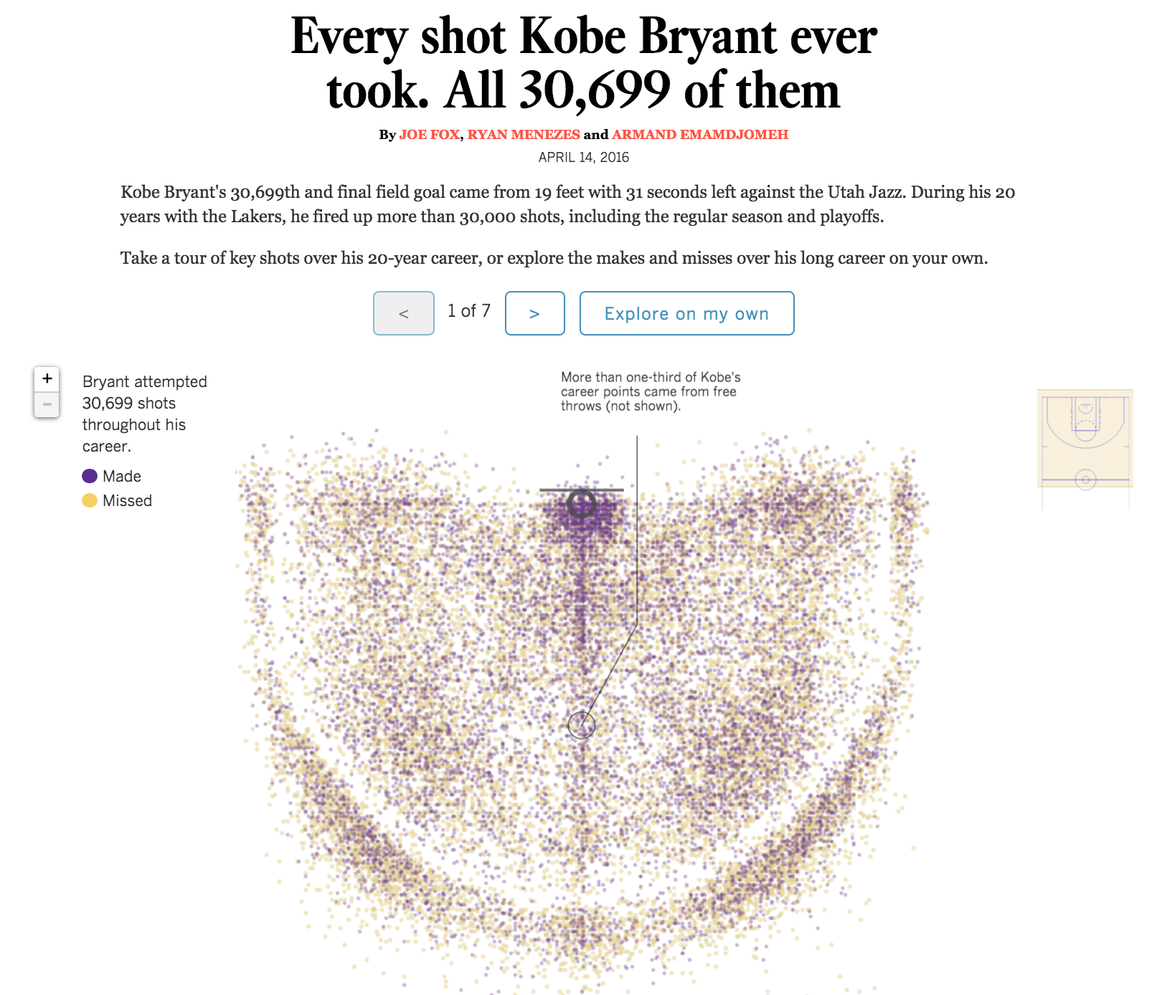
Martini Glass
http://graphics.latimes.com/kobe-every-shot-ever/

Slide 8
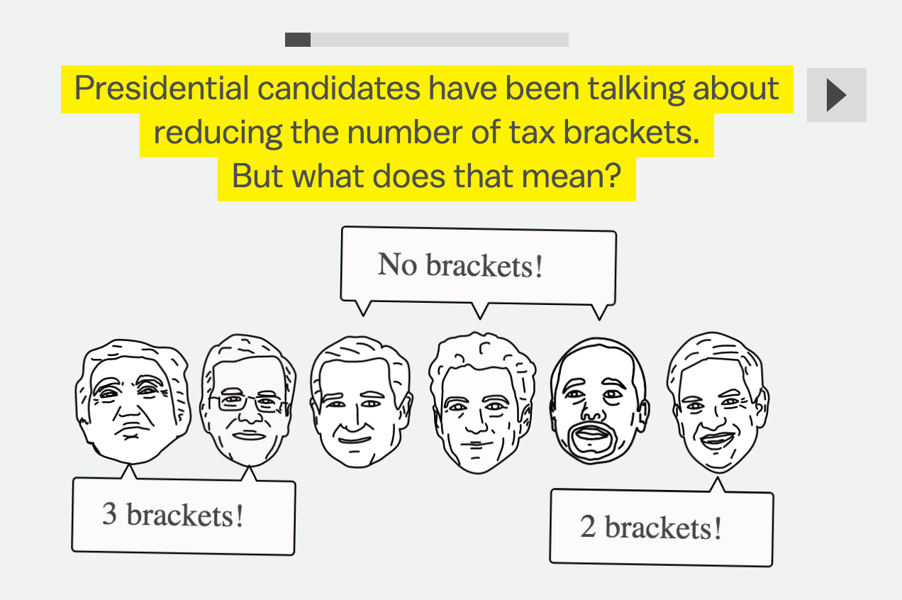
http://www.vox.com/2015/10/26/9469793/tax-brackets

Slide 9
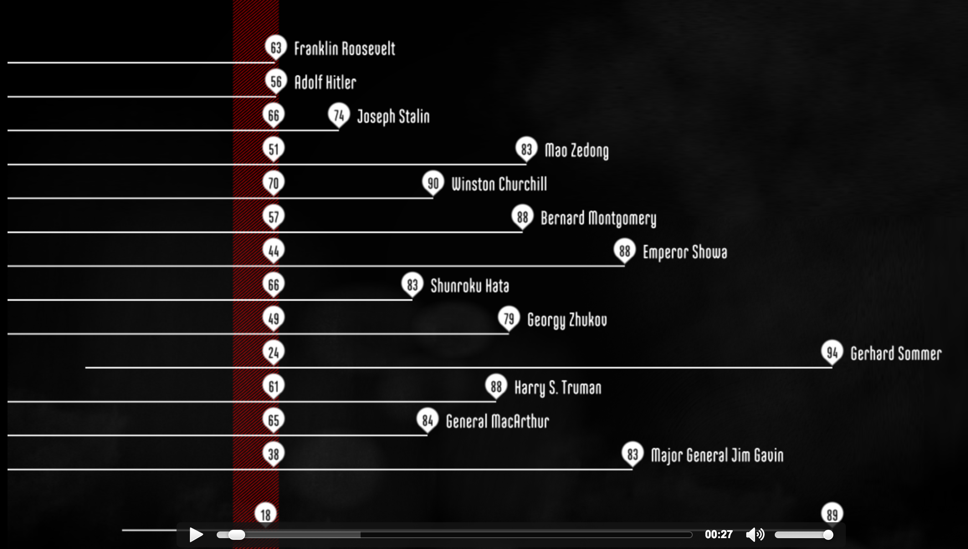
Data Docs – Martini Glass
http://www.fallen.io/ww2/
Notes:
Data docs draw much more on the conventions of film and video, with rich animation and narration to walk the viewer through the data, and integrating video or images as well.
But an interesting area for development is to integrate interactivity into data docs … about 7 minutes in. You might even call this an extreme version of martini glass (no interactivity for a long time, then all of a sudden a limited amount).

Slide 10
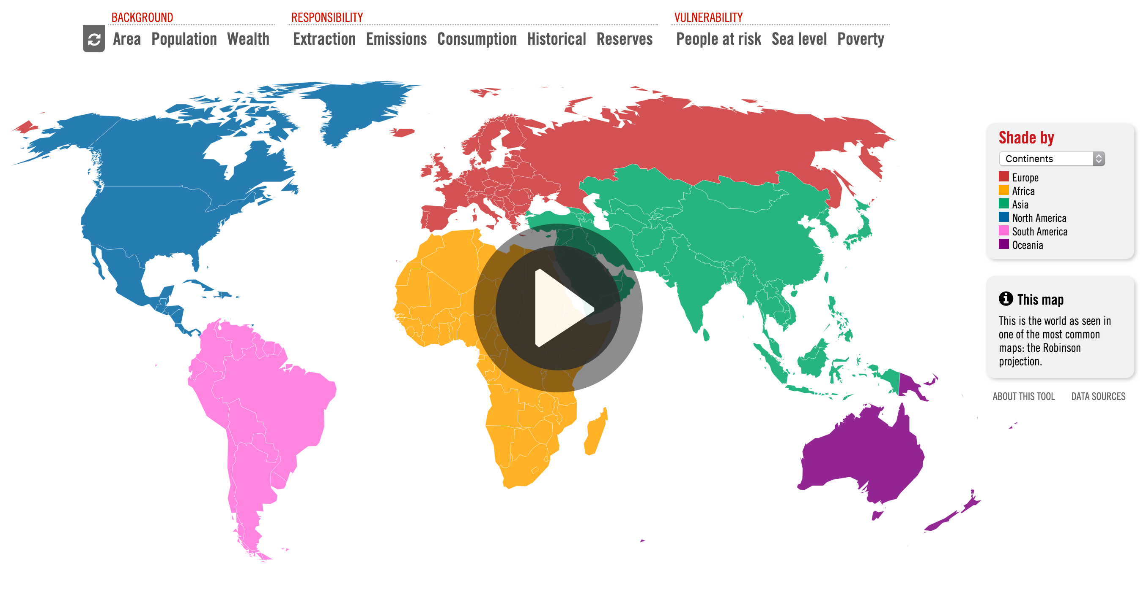
Animation – Martini Glass
http://www.carbonmap.org/#

Slide 11
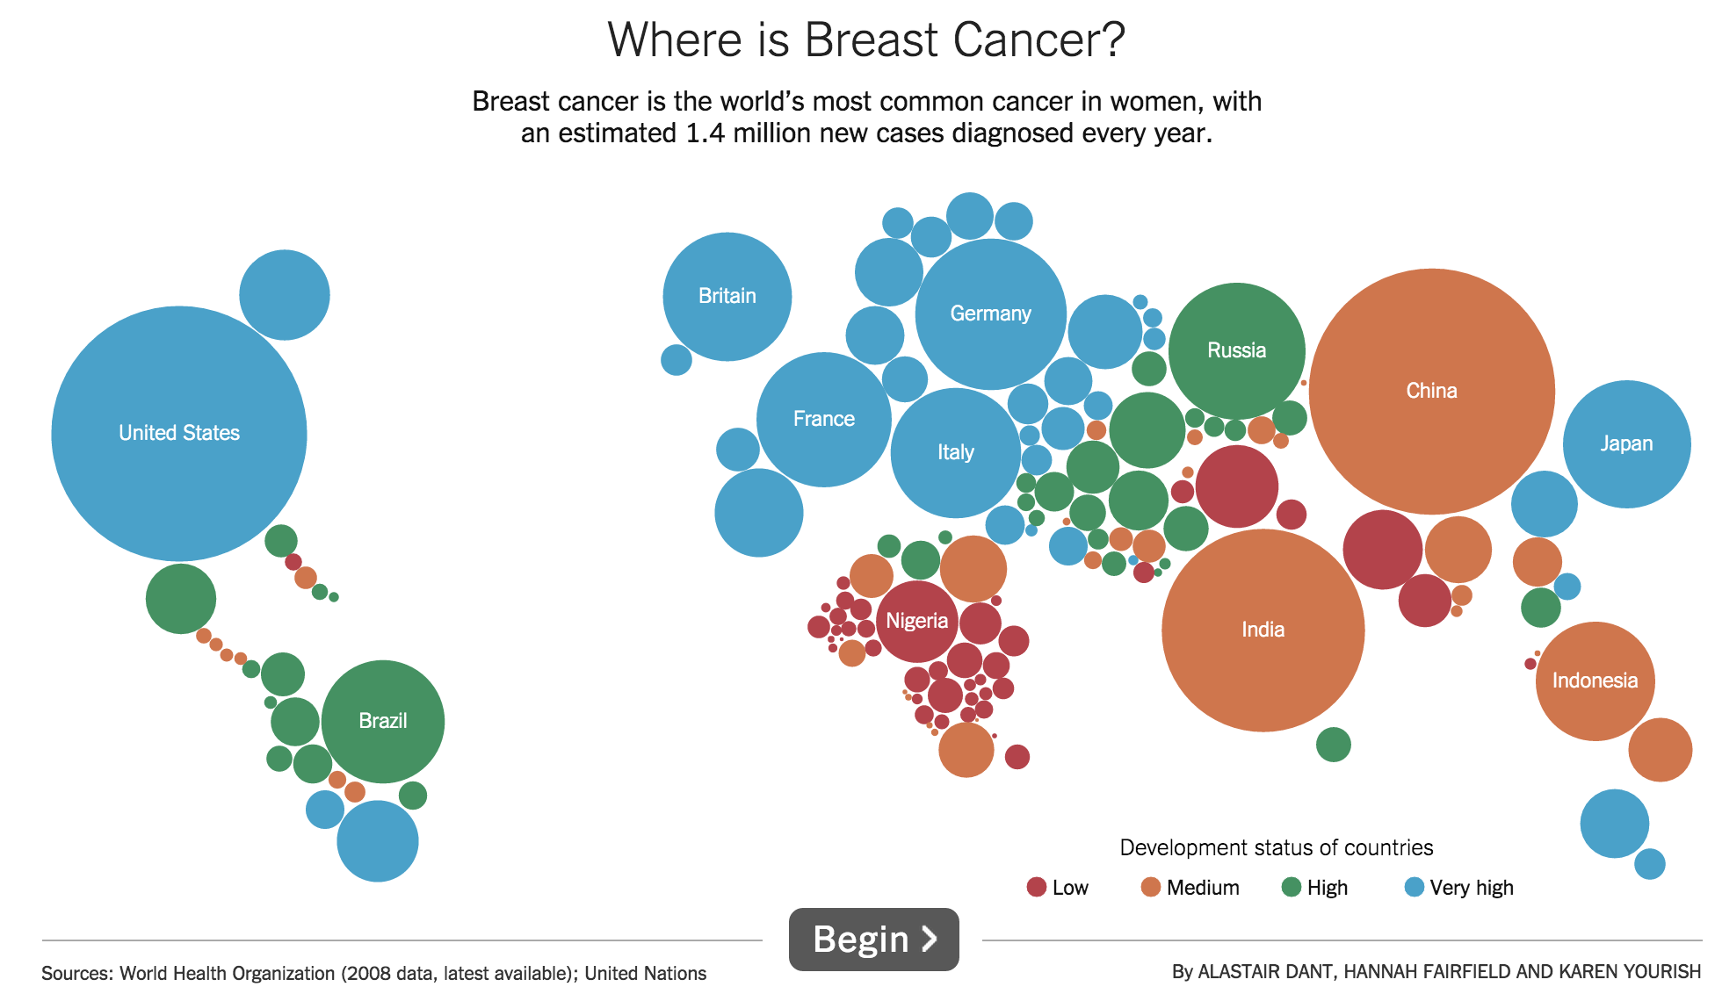
Interactive Slideshow
http://www.nytimes.com/2013/10/16/health/uganda-fights-stigma-and-poverty-to-take-on-breast-cancer.html?_r=1#g-graphic
Notes:
Steppers for advancing the story, don’t need voice over or action, but use annotation to tell story, labels to orient, animation to emphasize, aggregates for comparison.
http://www.nytimes.com/2013/10/16/health/uganda-fights-stigma-and-poverty-to-take-on-breast-cancer.html?_r=1#g-graphic

Slide 12
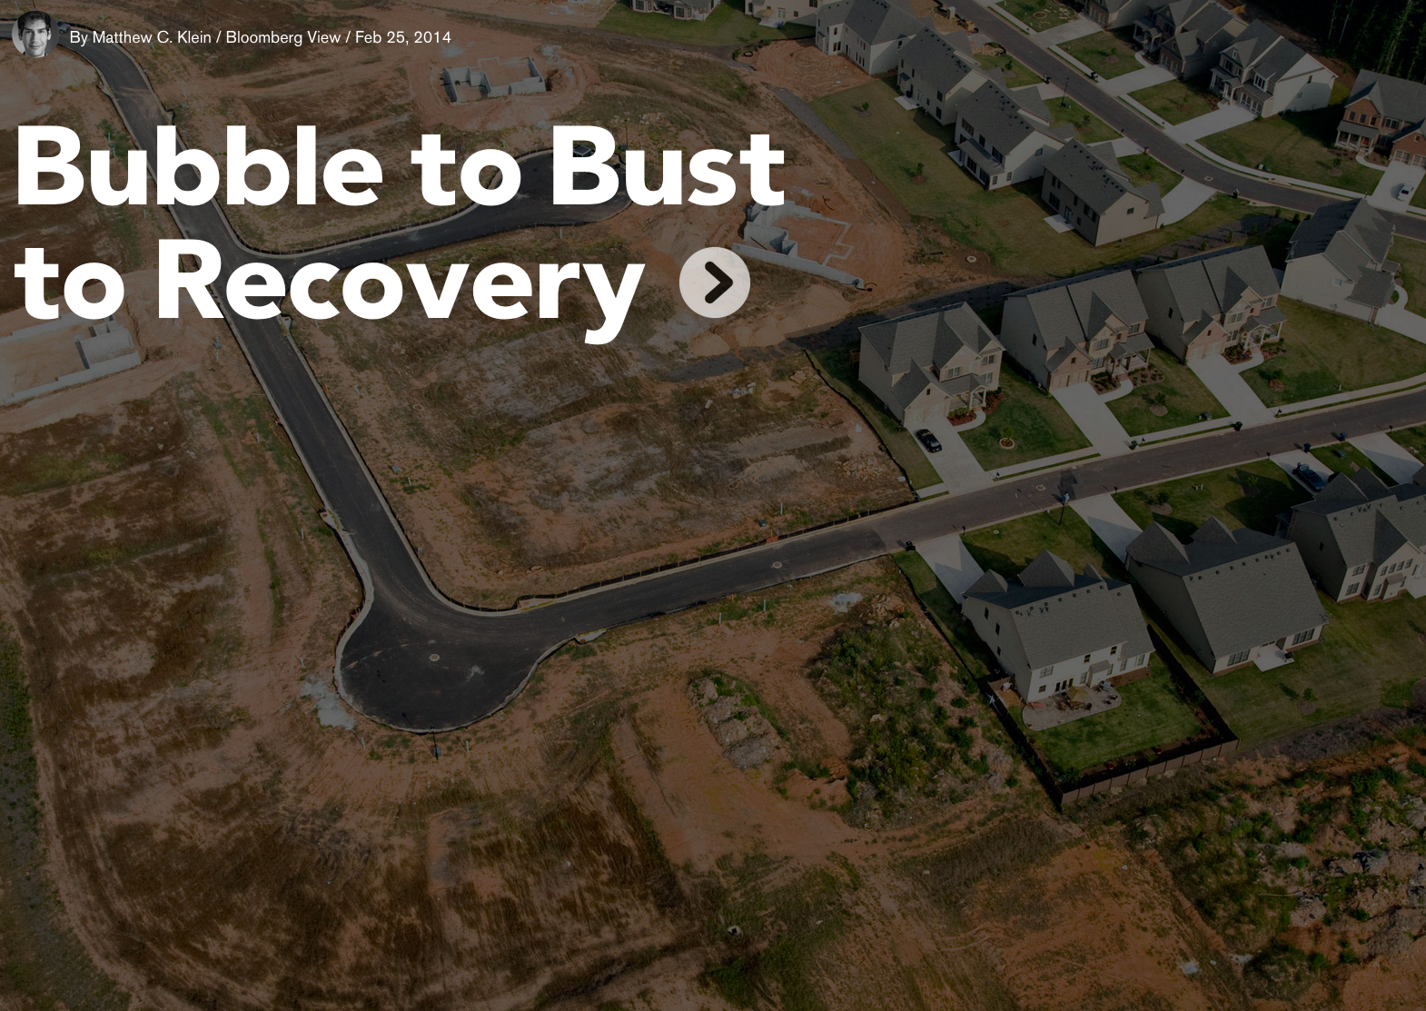
http://www.bloomberg.com/dataview/2014-02-25/bubble-to-bust-to-recovery.html
Notes:
Another example of an interactive slideshow.
http://www.bloomberg.com/dataview/2014-02-25/bubble-to-bust-to-recovery.html

Slide 13
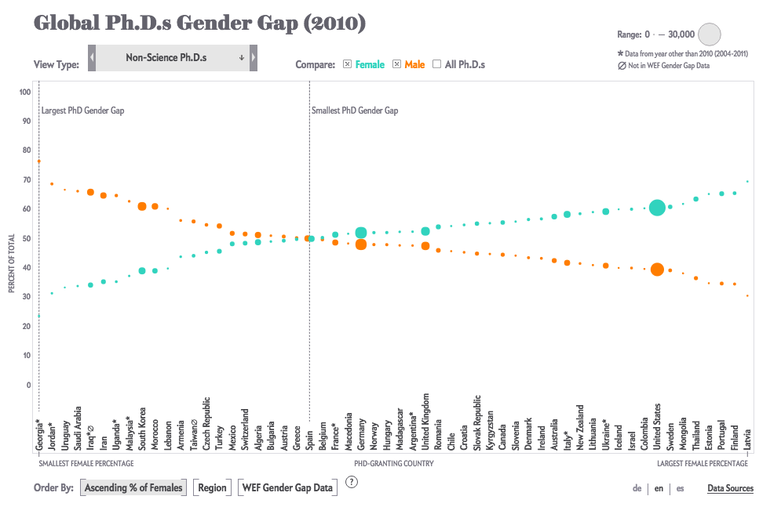
http://www.scientificamerican.com/article/how-nations-fare-in-phds-by-sex-interactive1/
Notes:
This is a really nice combination of both linear possibility and non-linear possibility. At every point you can advance linearly, jump, or alter things like what data is displayed, and how axes are mapped.

Slide 14
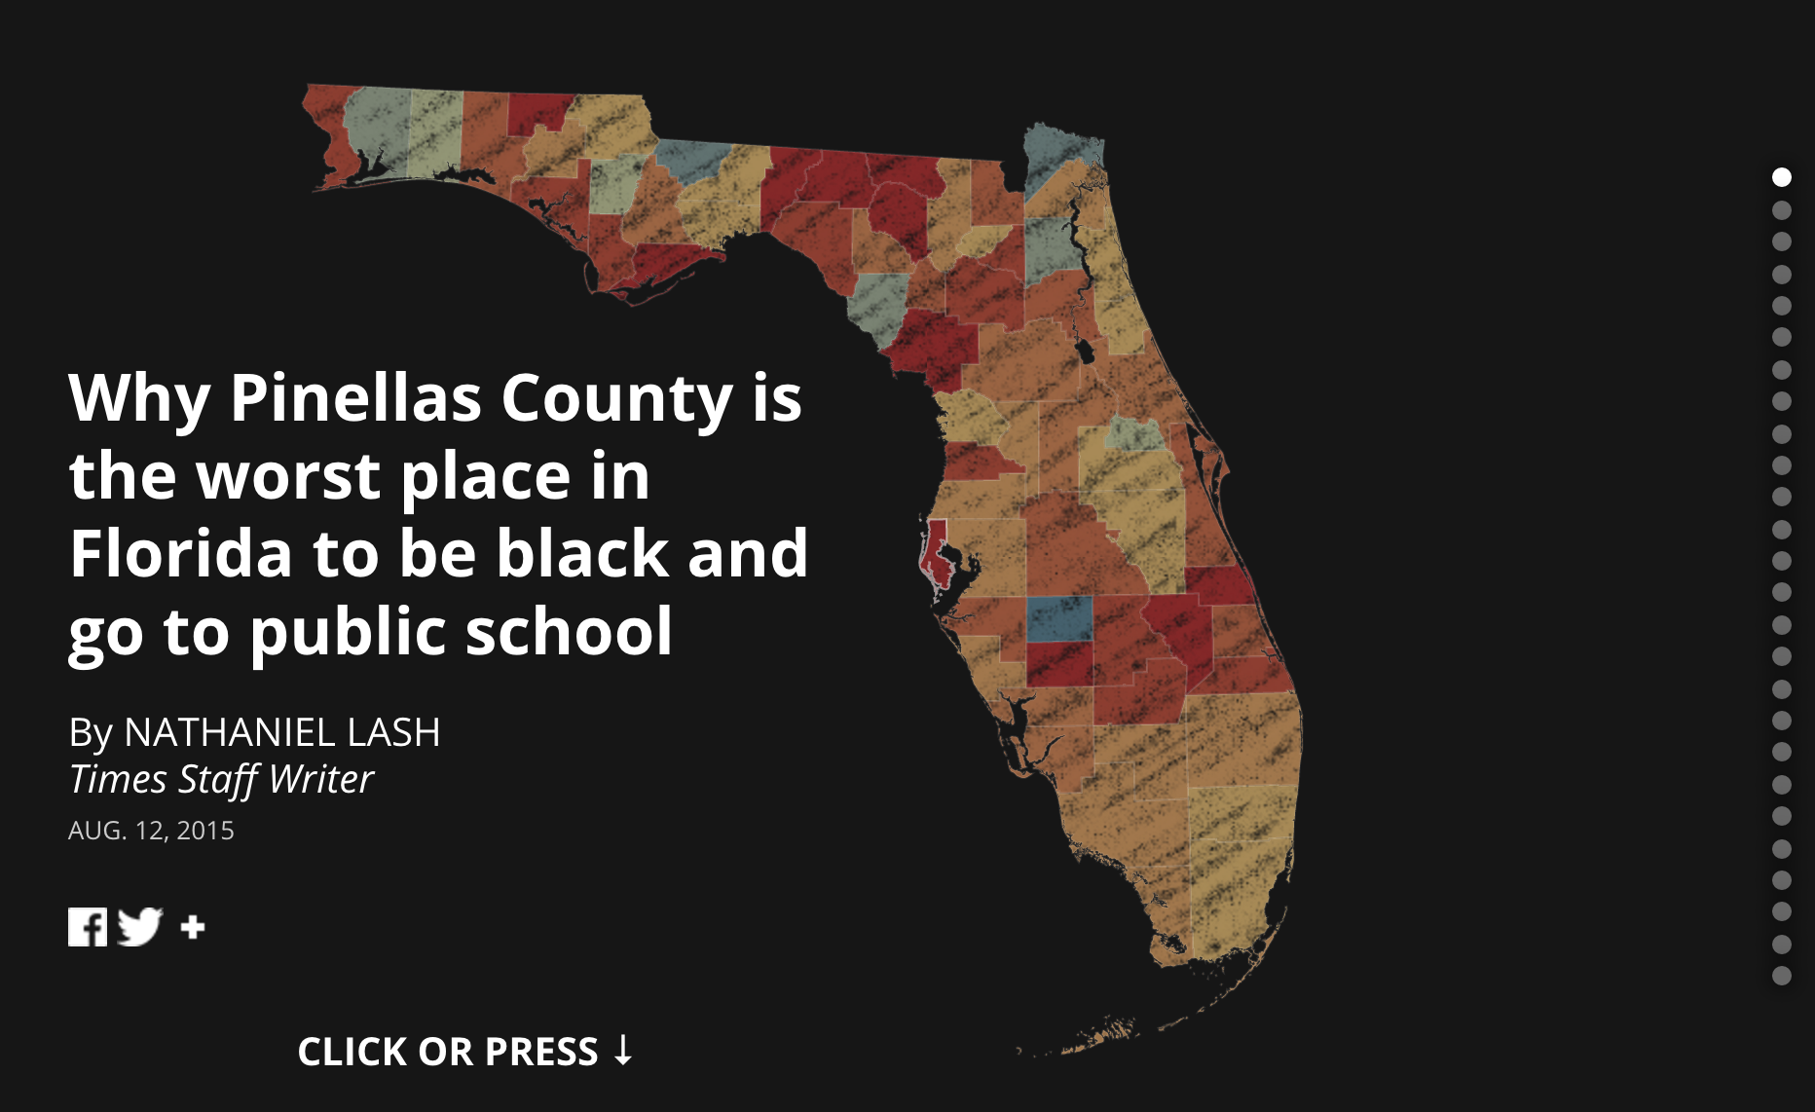
http://www.tampabay.com/projects/2015/investigations/pinellas-failure-factories/chart-failing-black-students/
Notes:
Another interactive slideshow. Note the dots that aid with navigation. Note how the text always reinforces what’s shown.

Slide 15
Storytelling Devices
As you progress through story in each step you could …
Add to elaborate OR Subtract to clarify
Reinforce to buttress OR Counter-argue to soften
Aggregate to generalize OR Disaggregate to individualize
How would any of these create tension? Release? Contribute to arc of story?
Notes:
To get more theoretical you could think of debate logic and how arguments are built step by step e.g. https://en.wikipedia.org/wiki/Toulmin_method
Several of these can be found in the last example showing the Florida schools.

Slide 16
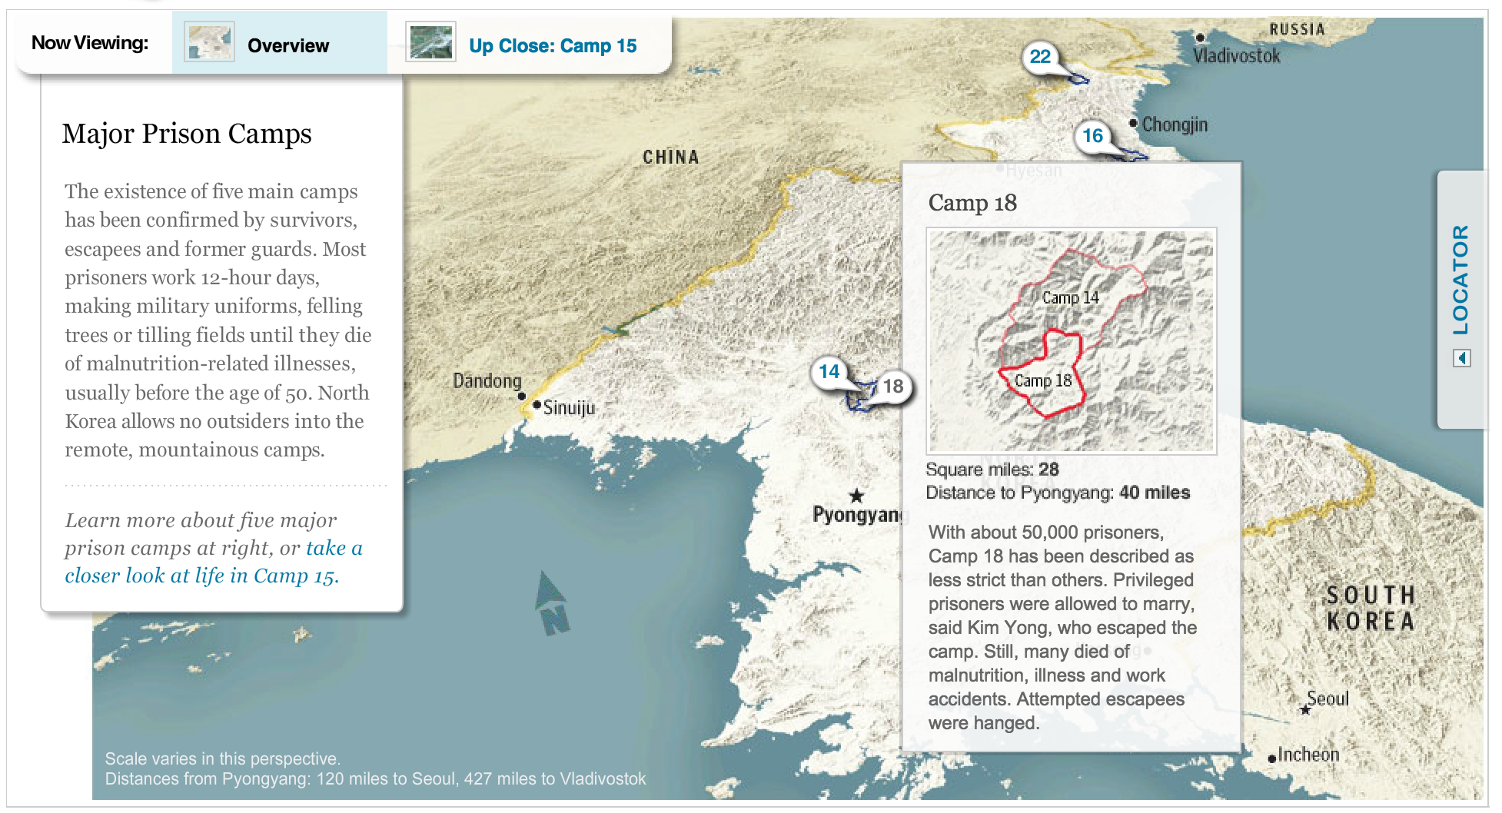
Drill Down
http://www.washingtonpost.com/wp-srv/special/world/north-korean-prison-camps-2009/
Notes:
http://www.washingtonpost.com/wp-srv/special/world/north-korean-prison-camps-2009/

Slide 17
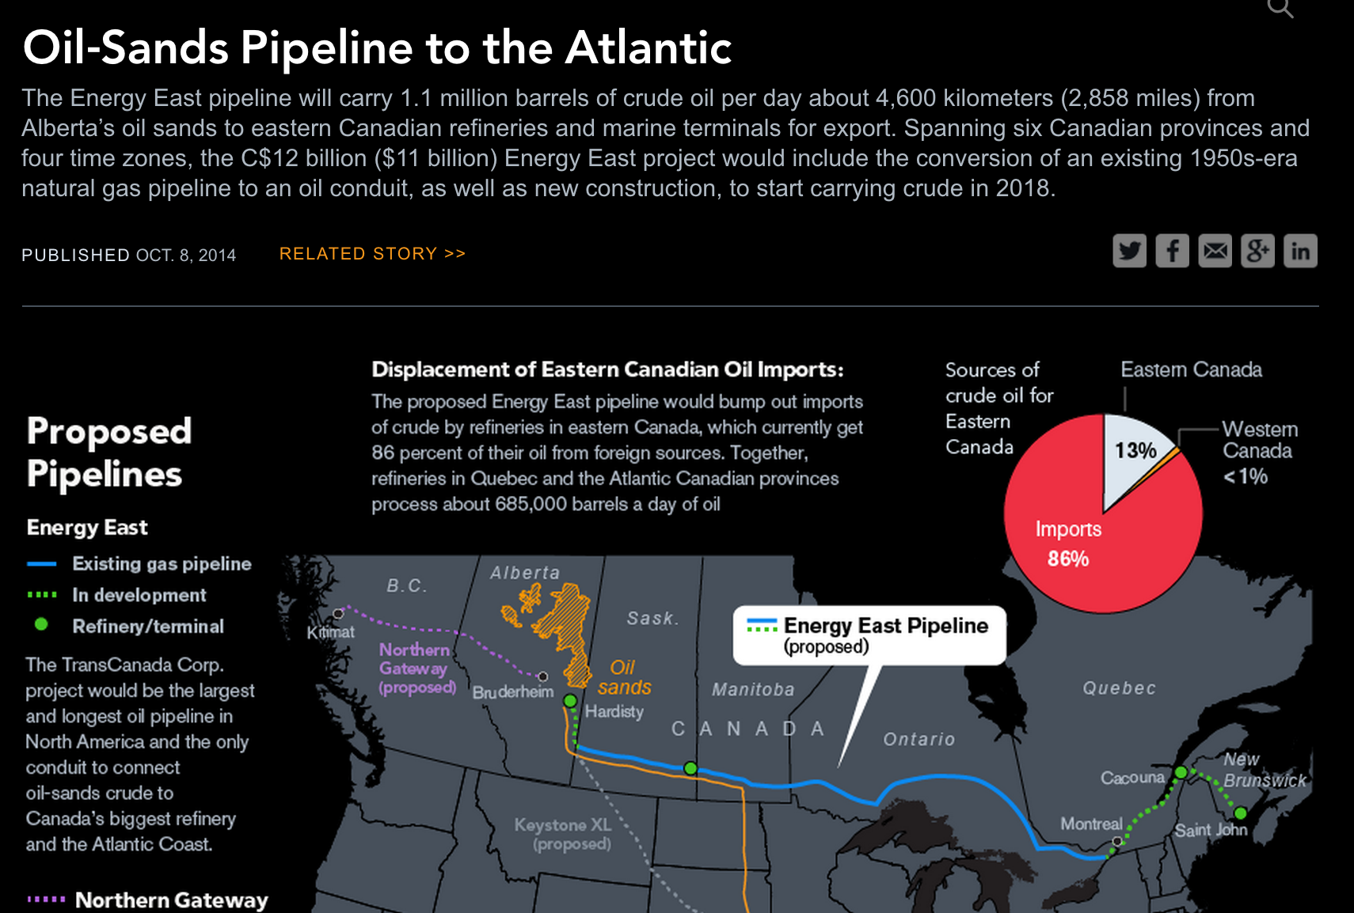
Poster-Style
Notes:
Partitioned poster is entire static but tells a story through a combination of graphics and text. Much more like an infographic

Slide 18
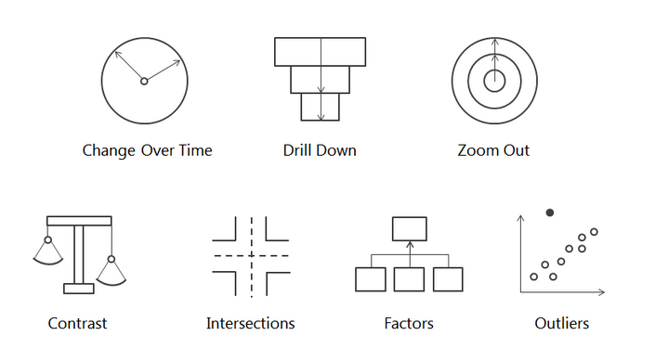
Seven Data Story Types
http://dataremixed.com/2015/03/tapestry-2015-seven-data-story-types/
Notes:
Here are 7 concrete cases where data stories can be found and told.
It’s easy to add historical context to events on a timeline, or to use animation to show how something is changing.
Drill down is all about showing an overview with an additional layer that you focus on; walking someone into specifics; kind of like Hannah progressive disclosure idea; also the idea of the reveal
Zoom out is kind of the opposite, where you start in close and then show someone the big picture; can talk about the near view and the far view.
Contrast – show difference between different slices (top and bottom are in different regions for instance)
Intersections – interesting events might happen at crossovers or provide loci for additional context adding
Factors break down an aggregate to reveal an underlying composition – a better label might be “break out”
Outliers are usually interesting because they’re different than the norm so they represent some exceptional case, but it’s important to explain why …

Slide 19
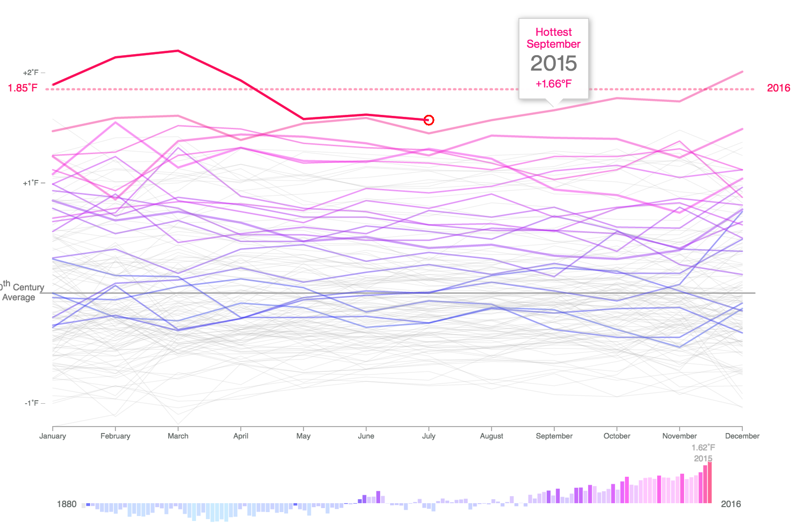
Change Over Time
http://www.bloomberg.com/news/features/2016-04-19/earth-s-temperature-just-shattered-the-thermometer
Notes:
Point out how animation can be a powerful tool here for showing change over time, but also point out the down side to animation which is that it’s hard to remember what it looked like at the beginning.
Animation can also make it easier to connect two different views, by smoothly transitioning between them.

Slide 20
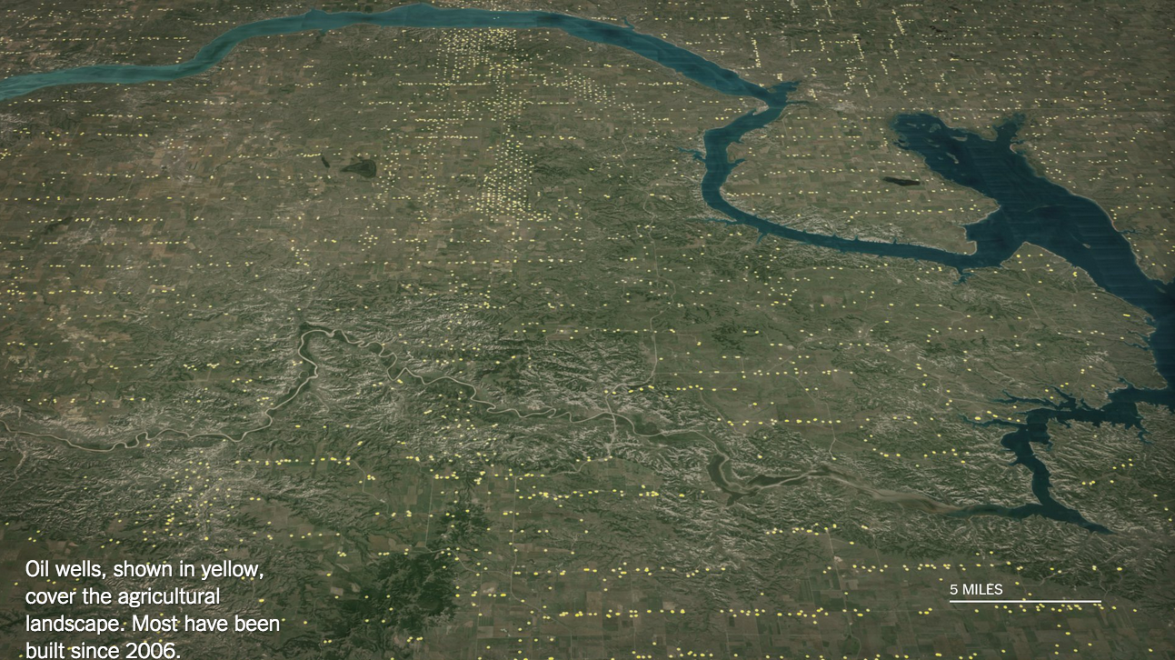
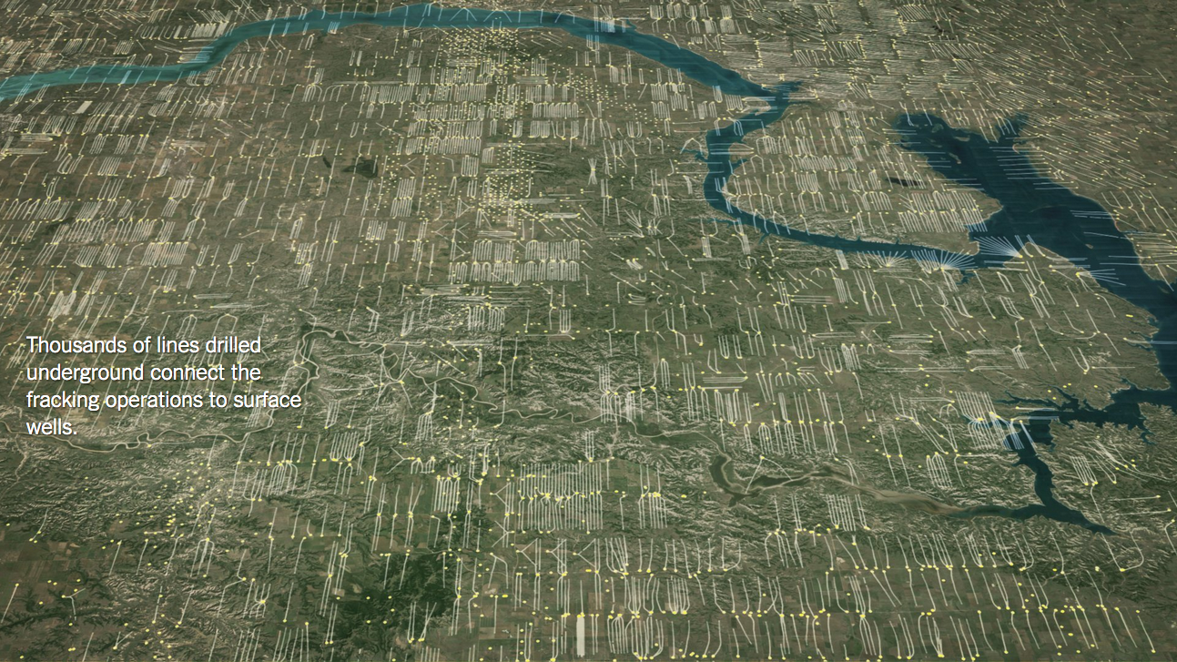
Drill Down - Revelation
http://www.nytimes.com/interactive/2014/11/23/us/north-dakota-oil-boom-downside.html
Notes:
http://www.nytimes.com/interactive/2014/11/23/us/north-dakota-oil-boom-downside.html
Storytelling starts from what the use knows. You can set them up and then reveal something stunning. This gets also to the importance of sequence.

Slide 21
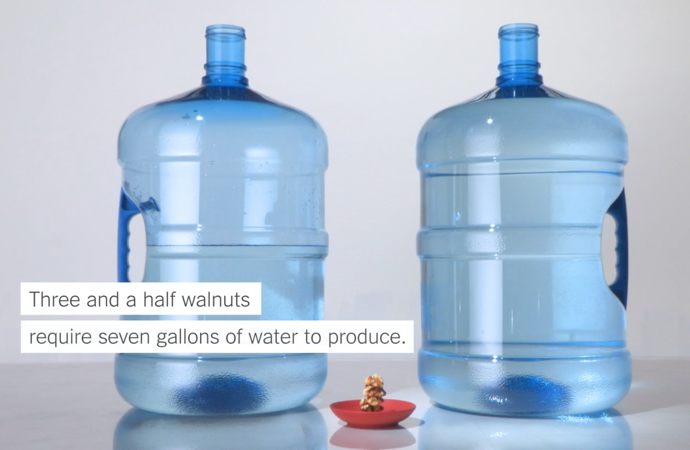
Zoom Out – Context / Compare
http://www.nytimes.com/interactive/2015/05/21/us/your-contribution-to-the-california-drought.html?_r=0
Notes:
Animation is used to reinforce the comparison here by transitioning between one quantity and another.

Slide 22
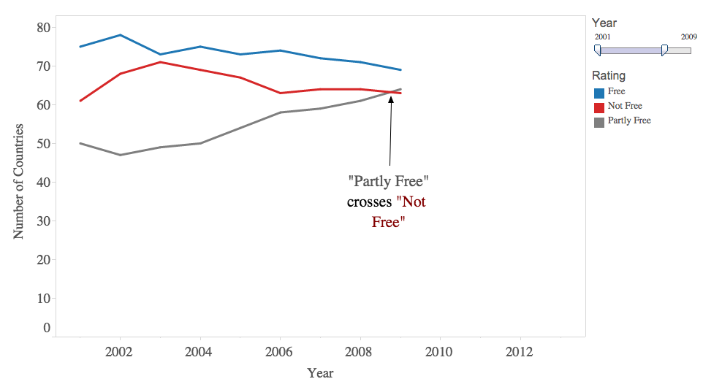
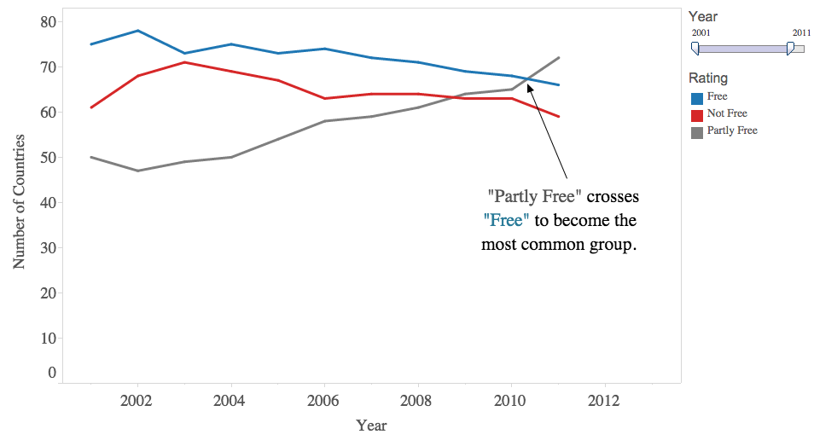
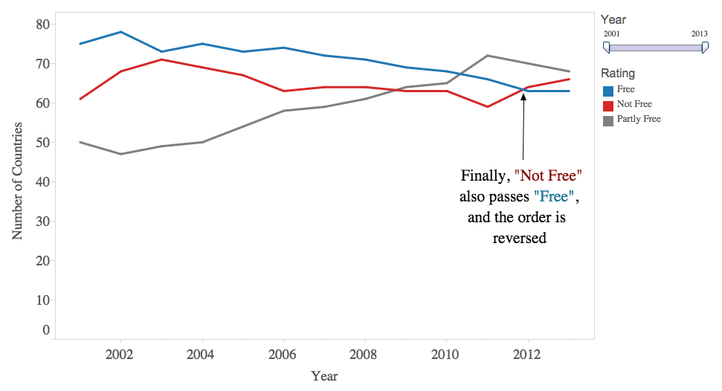
Intersections
Notes:
Country “freeness” rating.

Slide 23
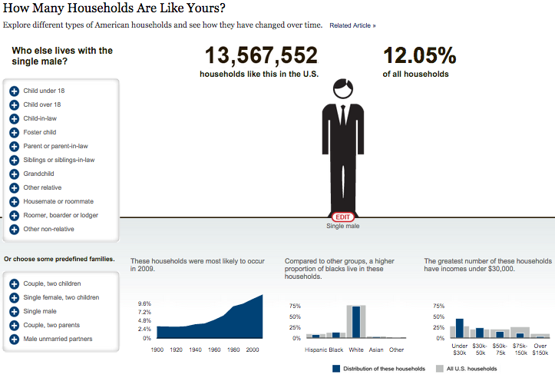
Stories of “You”
http://www.nytimes.com/interactive/2011/06/19/nyregion/how-many-households-are-like-yours.html
Notes:
You is a very important and compelling entry point to a data visualization because we’re all fascinated by how the world relates back to us. In fact it’s one way that perhaps we could even get people to care more broadly but start from a comfortable place.
You can allow someone to make relevant to themselves through questions or filters that allow them to adapt it, as in this example or the next, or you can use a click (to adapt to geography), or you can just leave it up to the end viewer to make the jump to compare to themselves on their own.

Slide 24
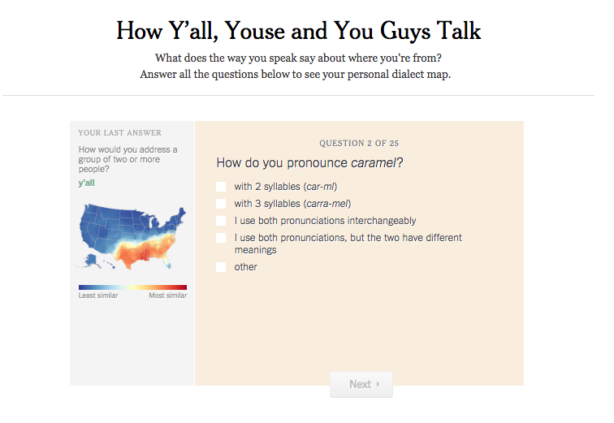
http://www.nytimes.com/interactive/2013/12/20/sunday-review/dialect-quiz-map.html
Notes:
What are some other ways you might turn a buzzfeed quiz into a visualizable aspect?
How might you adapt a visualization to personalize it to a person?

Slide 25
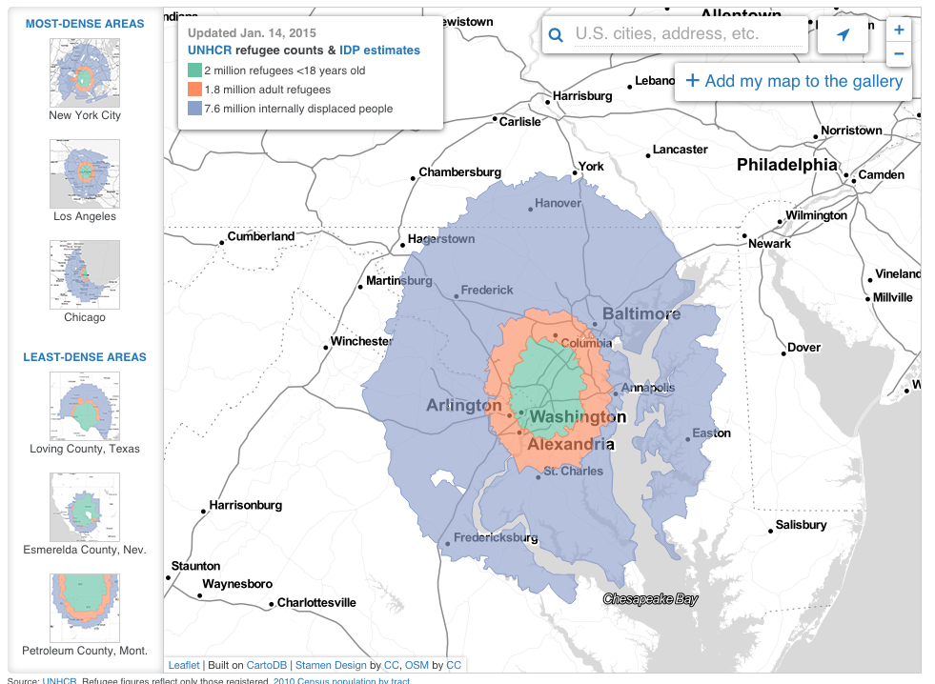
http://projects.aljazeera.com/2013/syrias-refugees/#38.996440488468075/-76.88610076904297
Notes:
Where would 11.4 million displaced Syrians fit?
Another example, that is not about “YOU” per se, but is about making something foreign relevant on a local level. So by clicking you define a relvance function.

Slide 26
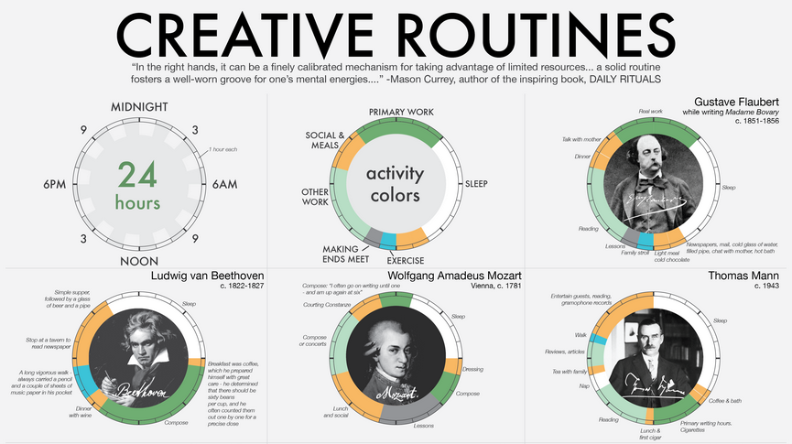
Self Comparison
https://infographwetrust.files.wordpress.com/2014/03/creative-routines-edit4.png
Notes:
Sometimes a vis may not be good at comparison, but it’s not about comparing across, it’s about comparing back to the individual who’s viewing. People can compare their own routine to the one of the famous person being depicted…

Slide 27
Interactivity
Navigation
Zoom, pan, advance, scroll, animation
View Manipulation
e.g. including all the things we talked about with exploratory vis
Parameterization
Drill down, reveal
More details (e.g. annotations), methods, labels, exact values

Slide 28
Interactive Feedback
Essential things should not be hidden
Show the current state
Selection, highlight, filter, sort, disabled
Delay can be deadly
UI should be “responsive”
Help to orient users
Where you are in navigation should be clear
Animation can sometimes help

Slide 29
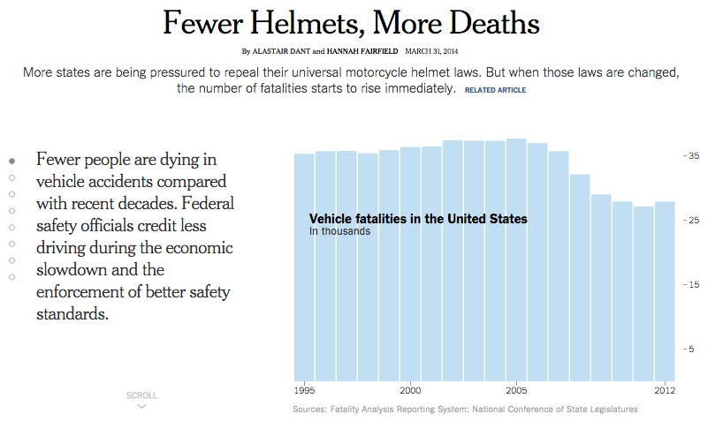
Interactivity - Navigation
http://www.nytimes.com/interactive/2014/03/31/science/motorcycle-helmet-laws.html
Notes:
Scrollytelling: Incidentally this works really well for mobile design since scrolling is a dominant modality there.
Point out importance of progress indicators as feedback to help orient user.
http://www.nytimes.com/interactive/2014/03/31/science/motorcycle-helmet-laws.html

Slide 30
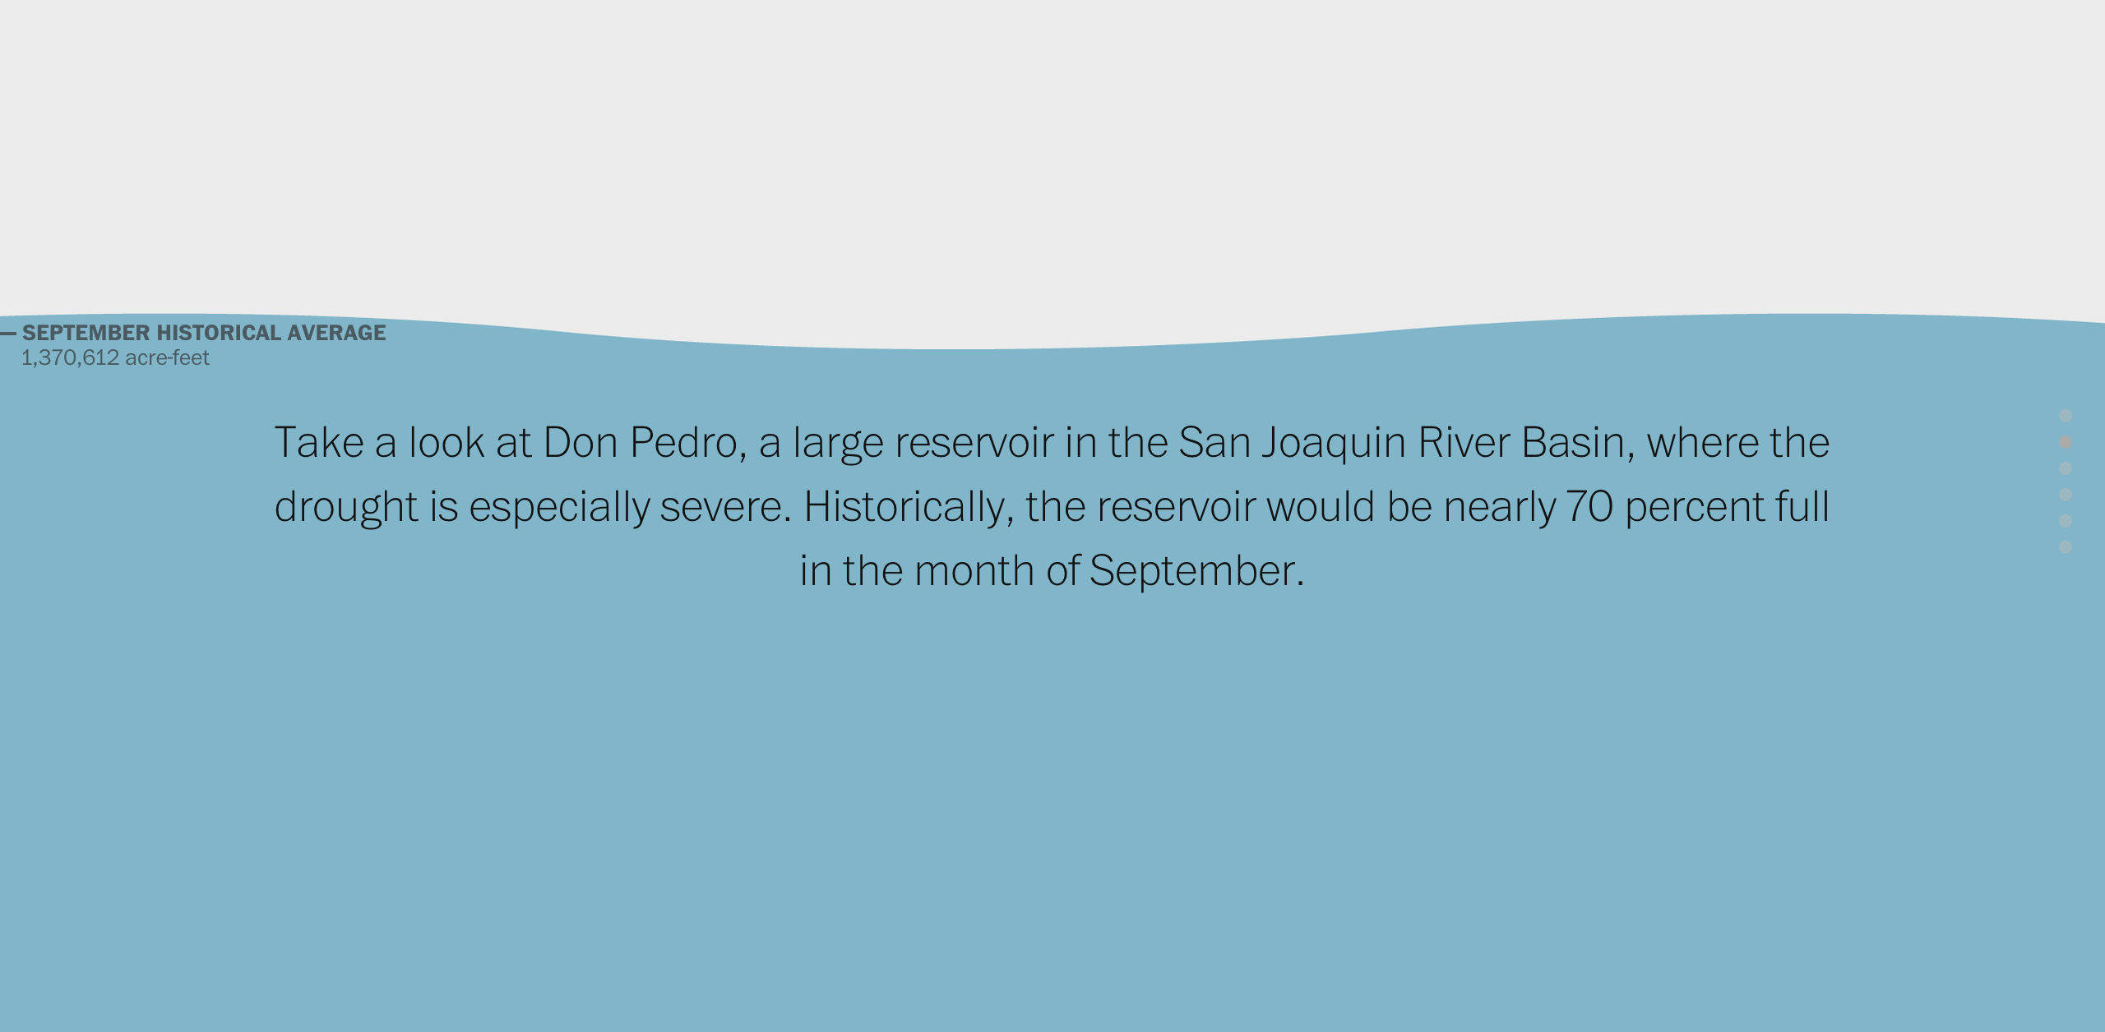
http://www.washingtonpost.com/graphics/national/drought-in-southwest/
Notes:
In this example the graphic takes over the whole screen and uses that screen with some animation in a creative way.

Slide 31
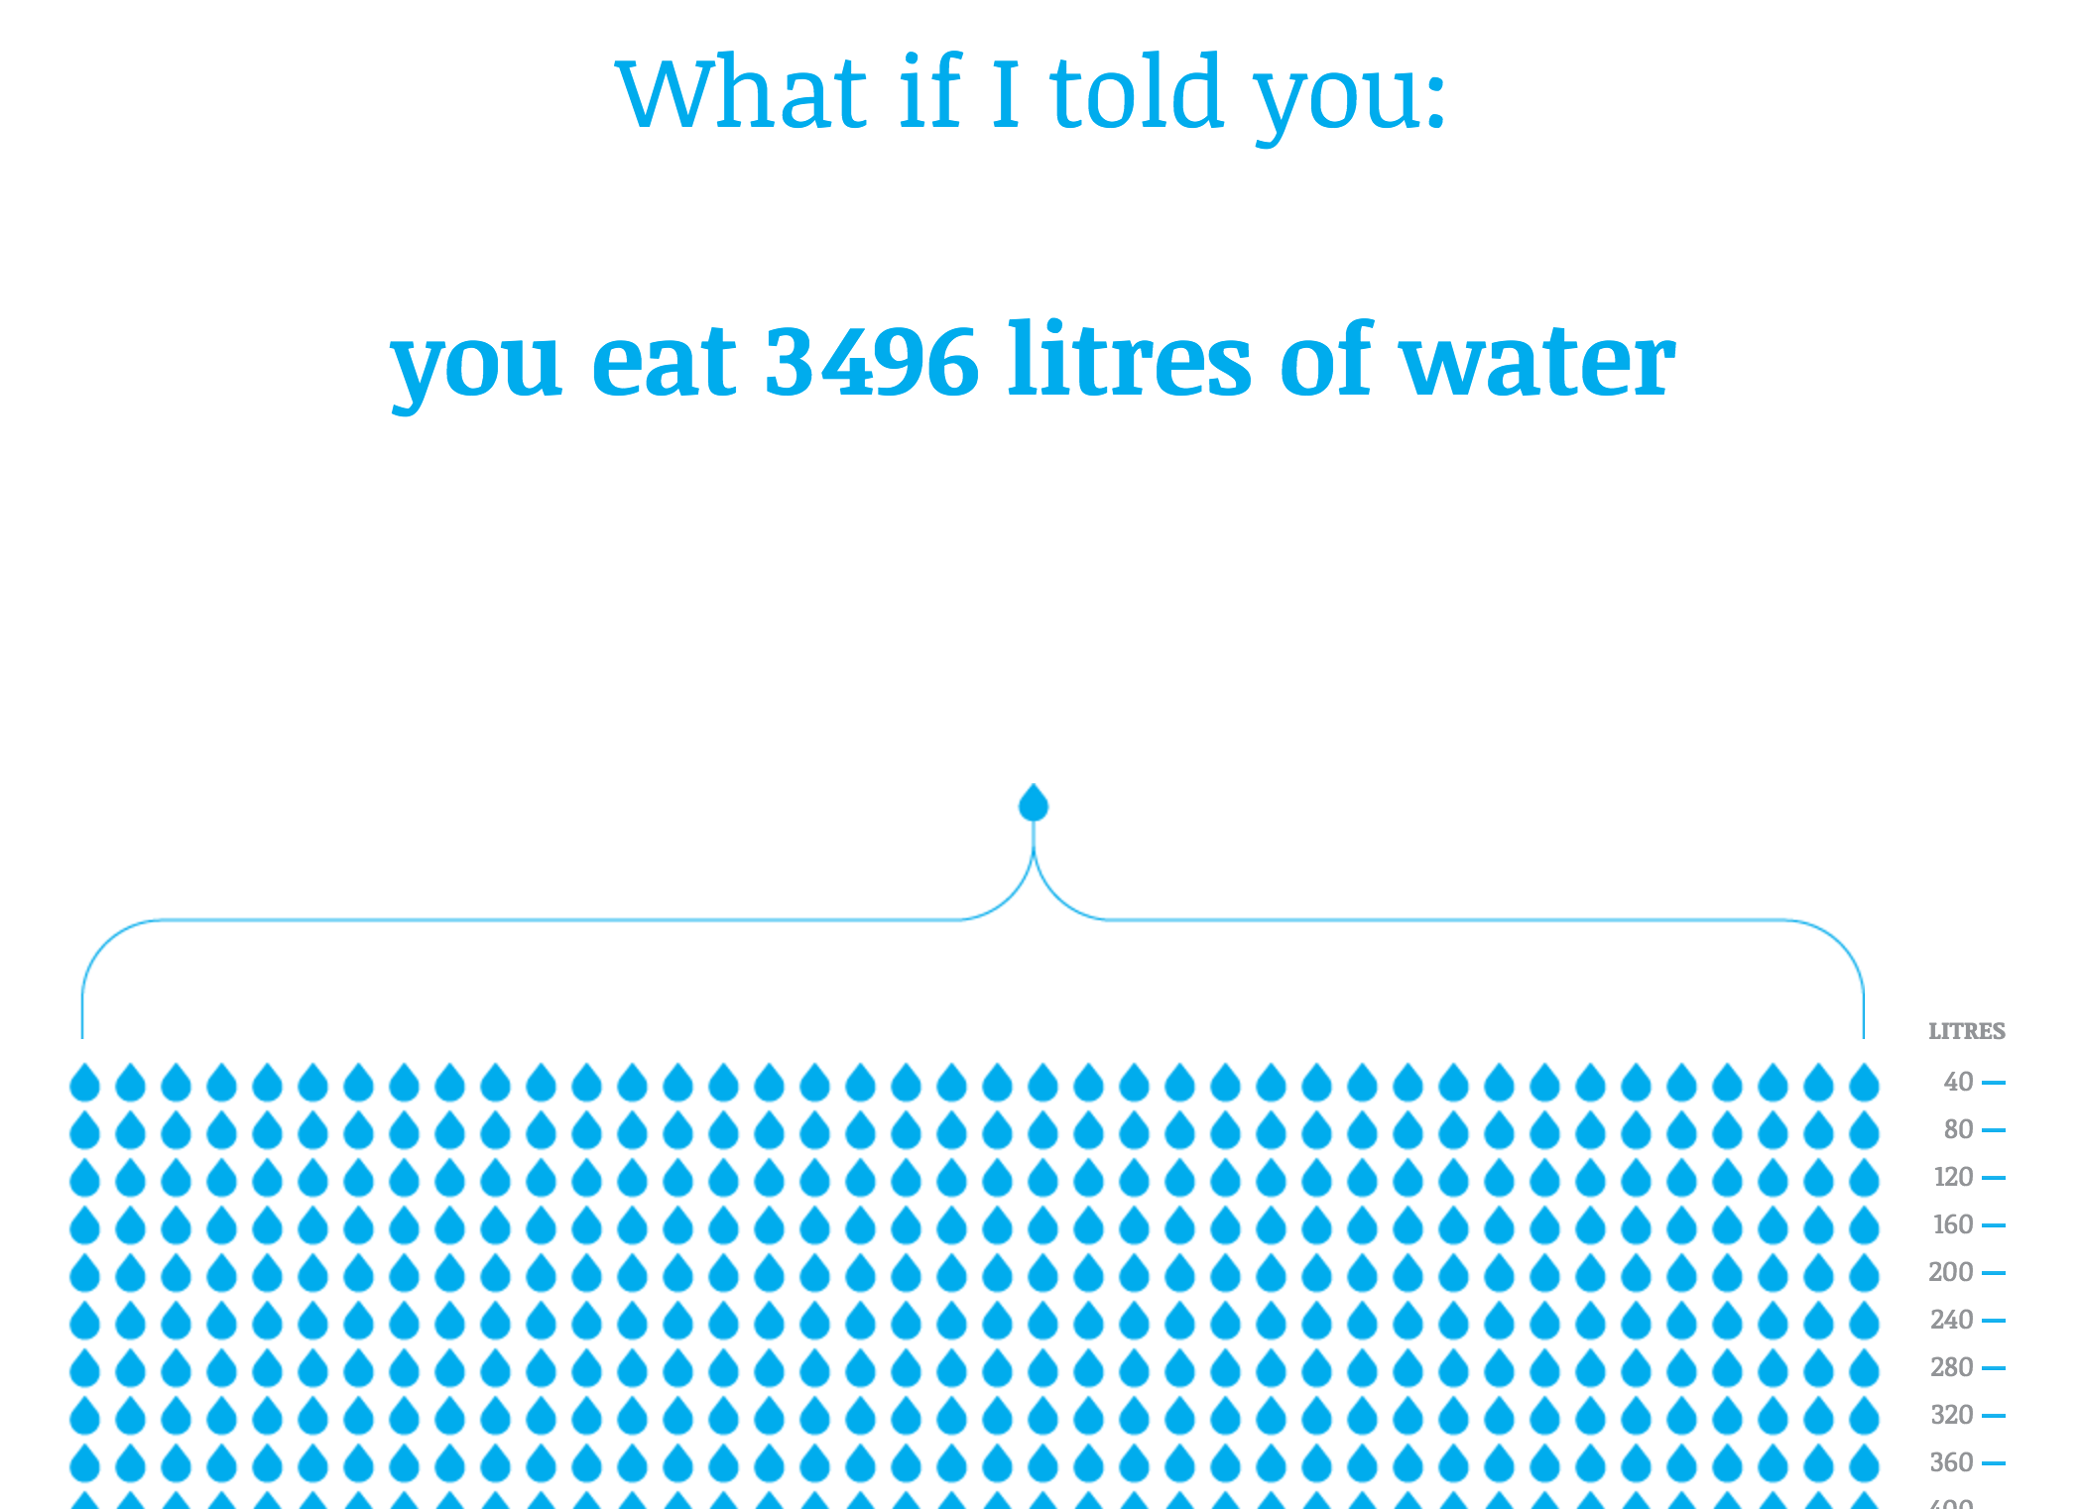
http://www.angelamorelli.com/water/

Slide 32
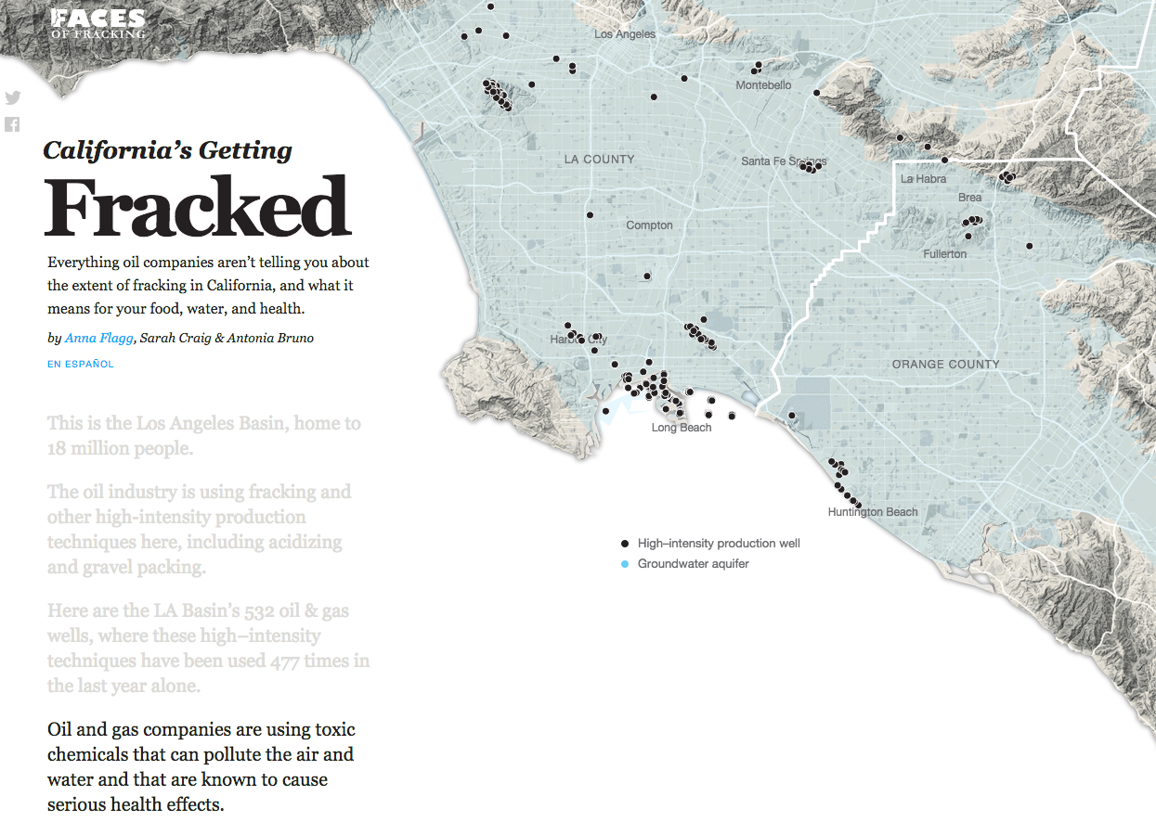
Notes:
Scroll-based narrative.
http://www.angelamorelli.com/water/

Slide 33
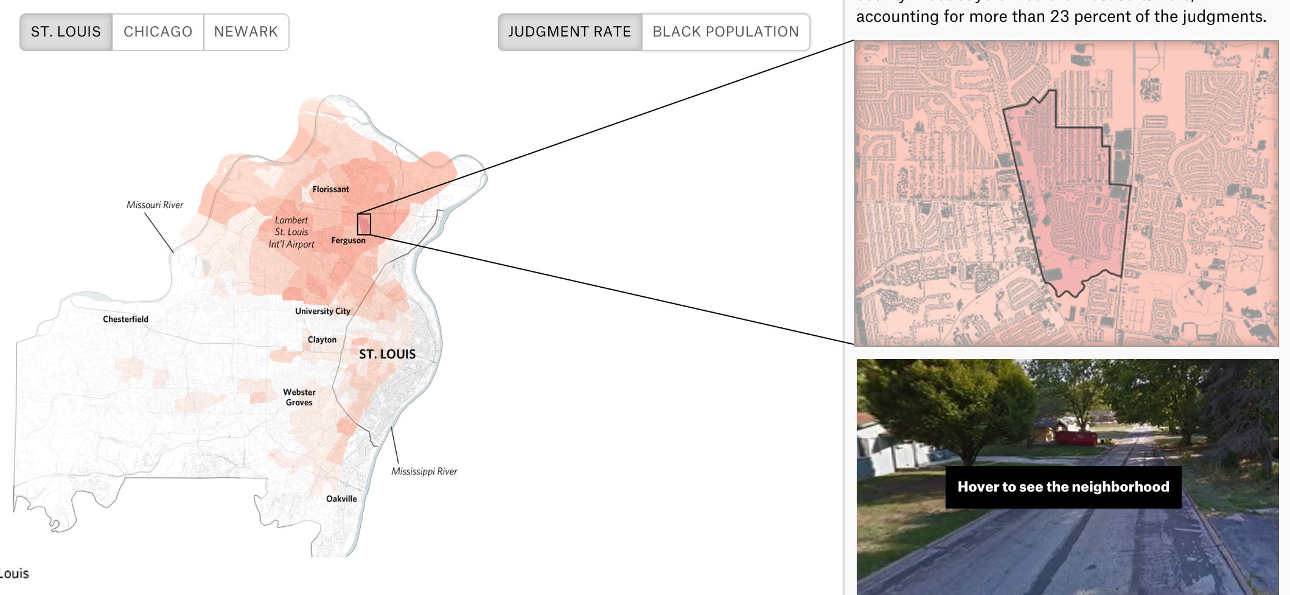
Scrollytelling
https://projects.propublica.org/garnishments/cities/st-louis/
Notes:
More scrollytelling … interesting about this example is how they use the map to locate the additional context provided on the right
https://projects.propublica.org/garnishments/cities/st-louis/

Slide 34
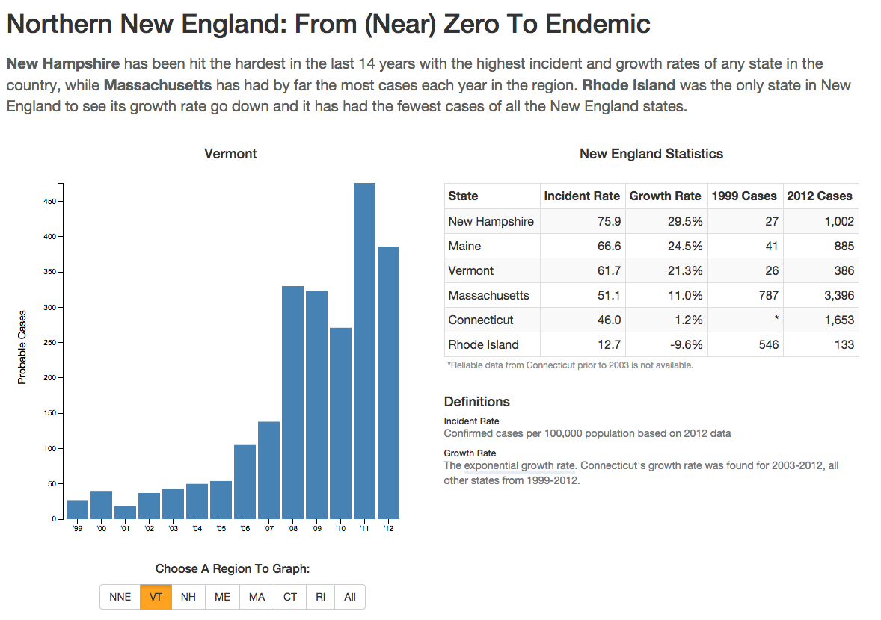
Interactivity - Animation
Notes:
An example showing how animation can be used to provide effective feedback in transitioning between different filter states.
http://www.vpr.net/apps/lyme-disease/

Slide 35




Interactivity - Affordances
Affordances
Information in the world is better than in the head (easier)
“The perceived and actual properties of the thing, primarily those properties that determine just how the thing could possibly be used”
Notes:
Perceived affordances: visual feedback that advertised the affordance
Affords: sitting, picking up, throw it, tieing a shoe, proping

Slide 36
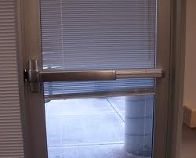
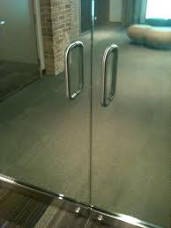


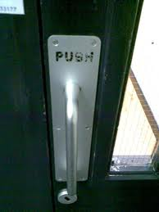
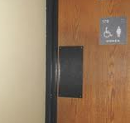
Notes:
Panic bar always used for fire doors because it forces the right behavior when people are panicked and not thinking
What other kinds of doors: sliding

Slide 37
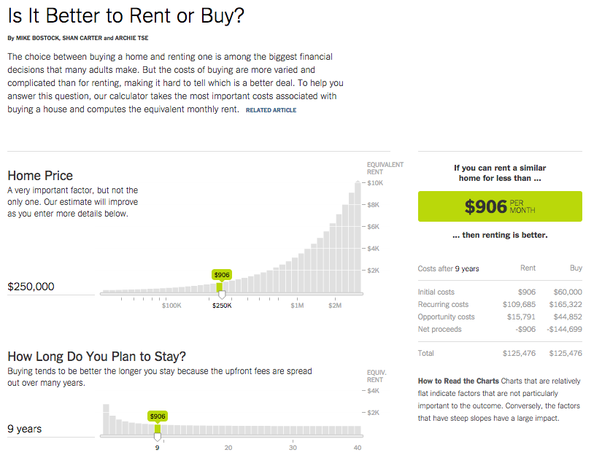
Interactivity - Parameters
Notes:
http://www.nytimes.com/interactive/2014/upshot/buy-rent-calculator.html?_r=0&abt=0002&abg=1
Relate to other parameters, view state, filter state, sort state, normalized data state, etc.
Point out the ease of parameterization – just dragging a slider
Can easily undo a parameter change
Can type in directly if you want
Parameters have smart defaults
Parameters are explained clearly

Slide 38
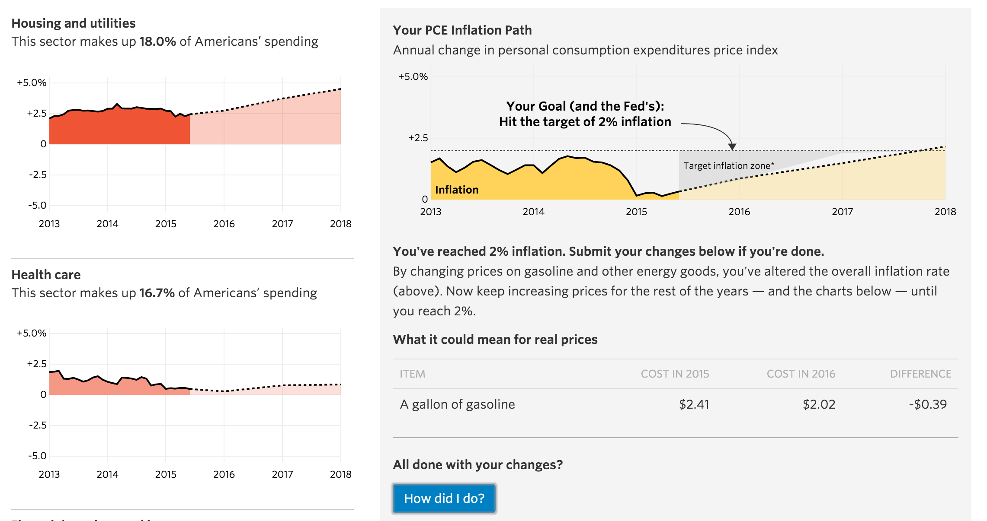
Interactivity - Games
http://graphics.wsj.com/beat-the-fed/
Notes:
Games are about creating goals for the user. Those goals can have interesting analytic side effects, like getting the user to consider certain parameters, view manipulations, variable combinations etc.
How to embed meaningful visual analytic interactions into game mechanics that in turn impact user behavior around the graphic
http://graphics.wsj.com/beat-the-fed/

Slide 39
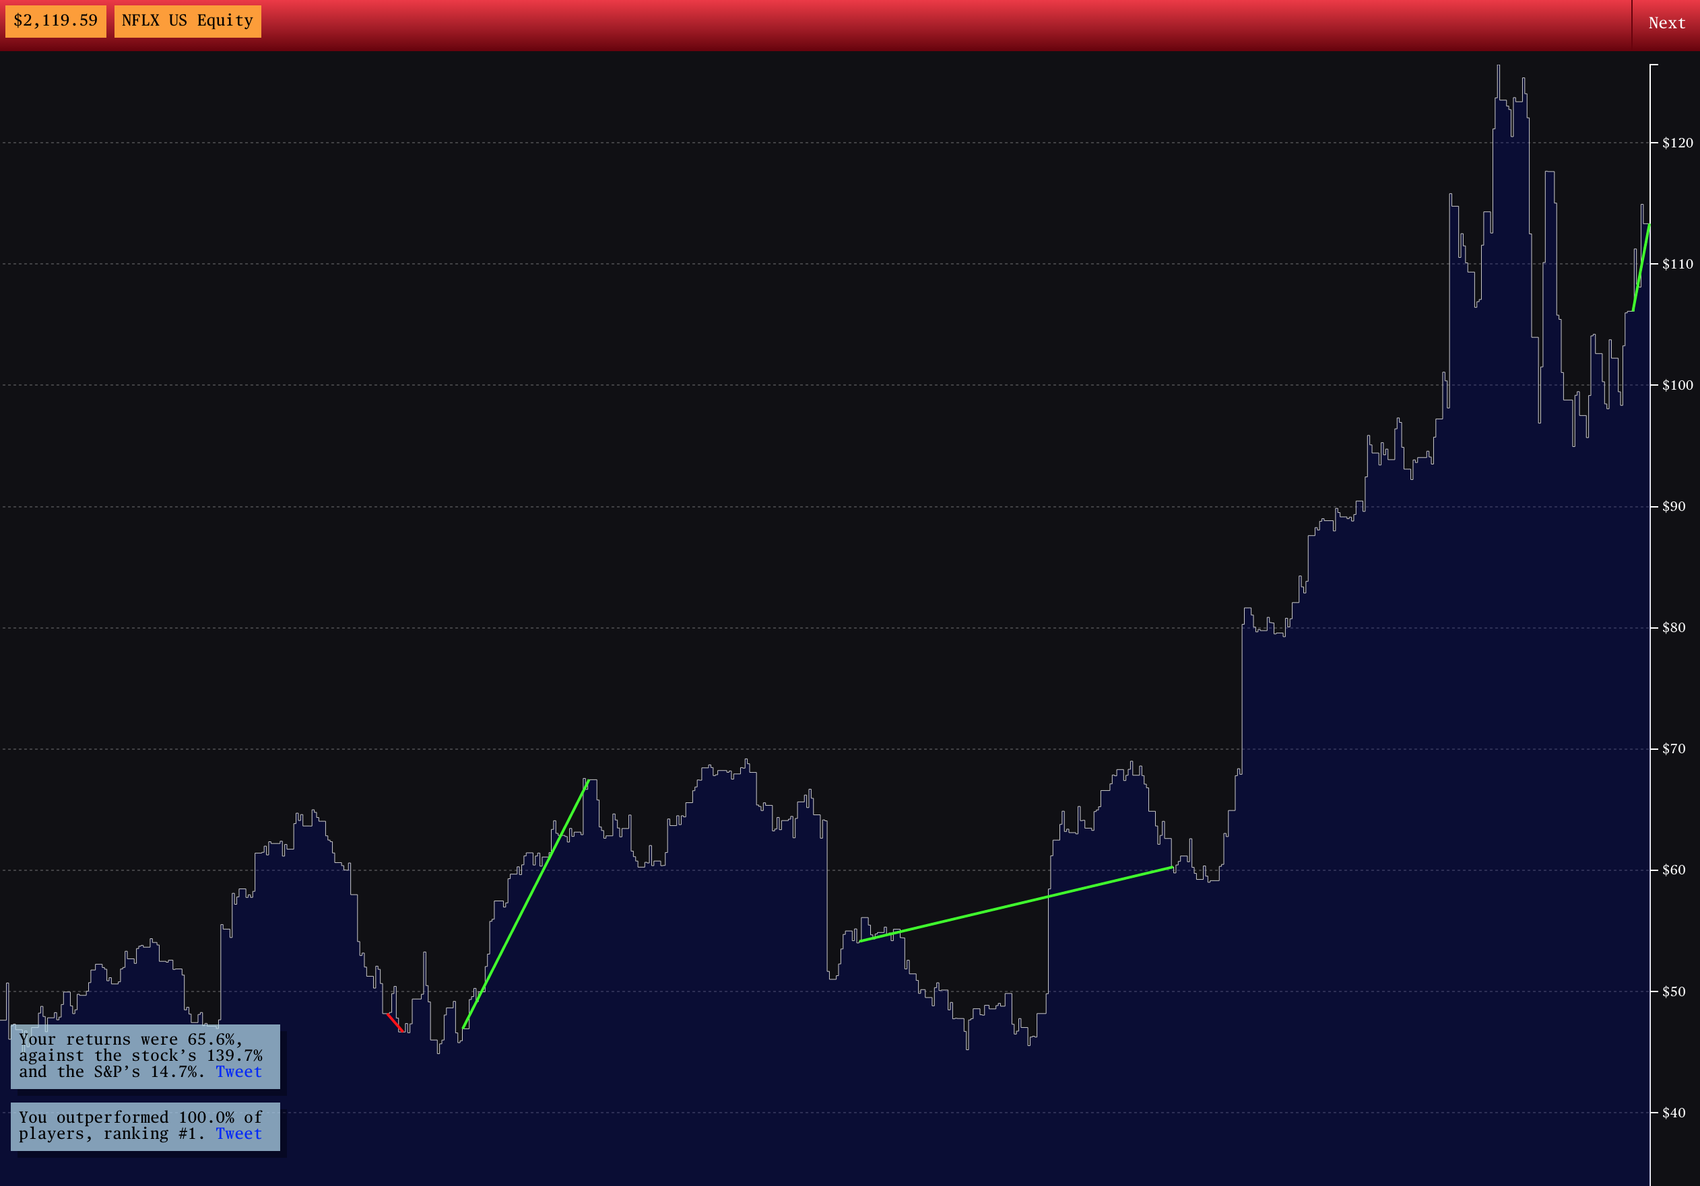
http://www.bloomberg.com/features/2015-stock-chart-trading-game/
Notes:
http://www.bloomberg.com/features/2015-stock-chart-trading-game/

Slide 40
Annotation
Essential for providing context to data
Guide interaction
Emphasize data
Prioritize particular interpretations
Pre-empt user curiosity for outliers, aberrations or trends
Effective data visualization needs effective writing!

Slide 41
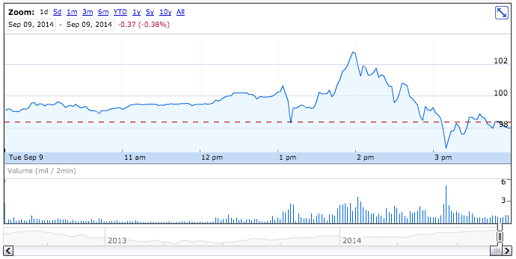
Apple Stock – 9/9/2014
Notes:
So for instance, you want to explain to the user what was happening with the stock at the interesting points.
Apple Pay is the spike up, iWatch is the spike down afterwards

Slide 42
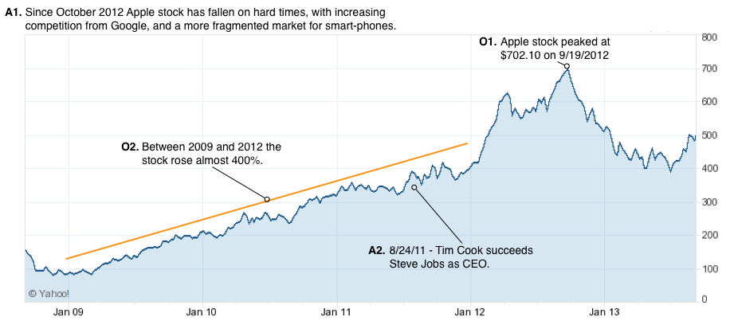
Types of Annotations
J. Hullman, N. Diakopoulos, E. Adar. Contextifier: Automatic Generation of Annotated Stock Visualizations. Proc. CHI. 2013.
Notes:
Additive and observational
3 granularities: entire, group / region, and single data point.
Observational annotations provide context by supporting reflection on a data value or group of values that are depicted in the visualization. These annotations facilitate comparisons and often highlight or emphasize extreme values or other outliers. For interactive graphics they are sometimes revealed when hovering over a visual element.
Additive annotation provides context that is external to the visual representation and not clearly depicted via the data. These are things that are relevant to the topic or to understanding the data, like background or contemporaneous events or actions.

Slide 43
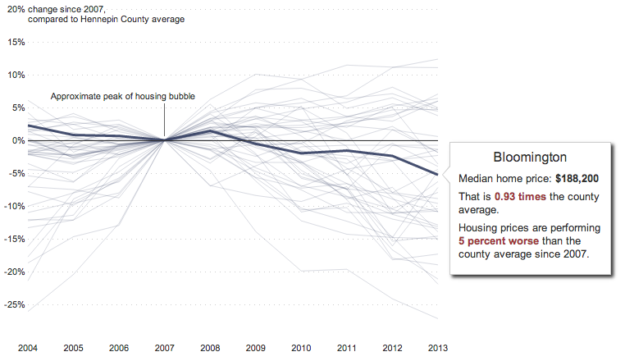
Notes:
The following example from The Minneapolis Star Tribune shows changes in home prices across counties in Minnesota with reference to the peak of the housing bubble, a key bit of additive annotation attached to the year 2007. At the same time, the graphic also uses observational annotation (on the right side) by labeling the median home price and percent change since 2007 for the selected county.

Slide 44
Type Prevalence
J. Hullman, N. Diakopoulos, E. Adar. Contextifier: Automatic Generation of Annotated Stock Visualizations. Proc. CHI. 2013.
Notes:
Use of these types of annotation is very prevalent; in our study of 136 examples we found 120 (88.2%) used at least one of these forms of annotation

Slide 45
Principles of Analytic Design
“consumers of evidence presentations should look for appropriate comparisons, assessments of causality, multivariateness, use of relevant data, credible documentation, content-reasoning”
-Edward Tufte

Slide 46
Tufte’s Principles
Comparisons
Show comparisons, contrasts, differences
Causality, Mechanism, Structure, Explanation
Multivariate Analysis
Integration of Evidence
Completely integrate words, numbers, images, diagrams
“whatever it takes to explain something”
Documentation
Content
Notes:
Compared to what: changes over space or time, normalizing,
Causality: Tufte’s example is the temperature in the minard graphic. Also need to be careful about causal inferences – does a slight correlation prove that A causes B? No!
Multivariate: show more than 1 or 2 dimensions
Documentation: what is the display about; who did the work; who’s that; what are the data sources; any assumptions
Content: is it substantive; knowledge of content and care for the substance; opposite of design devices or gimmicks

Slide 47

Causality?
Notes:
Minard’s graphic which Tufte praises highly. Something to consider is the extent to which it’s valid to suggest that the cold was really the cause of the loss of troops on the way back. Even though there’s a parallel and visually the two line up, is that “correct”?

Slide 48
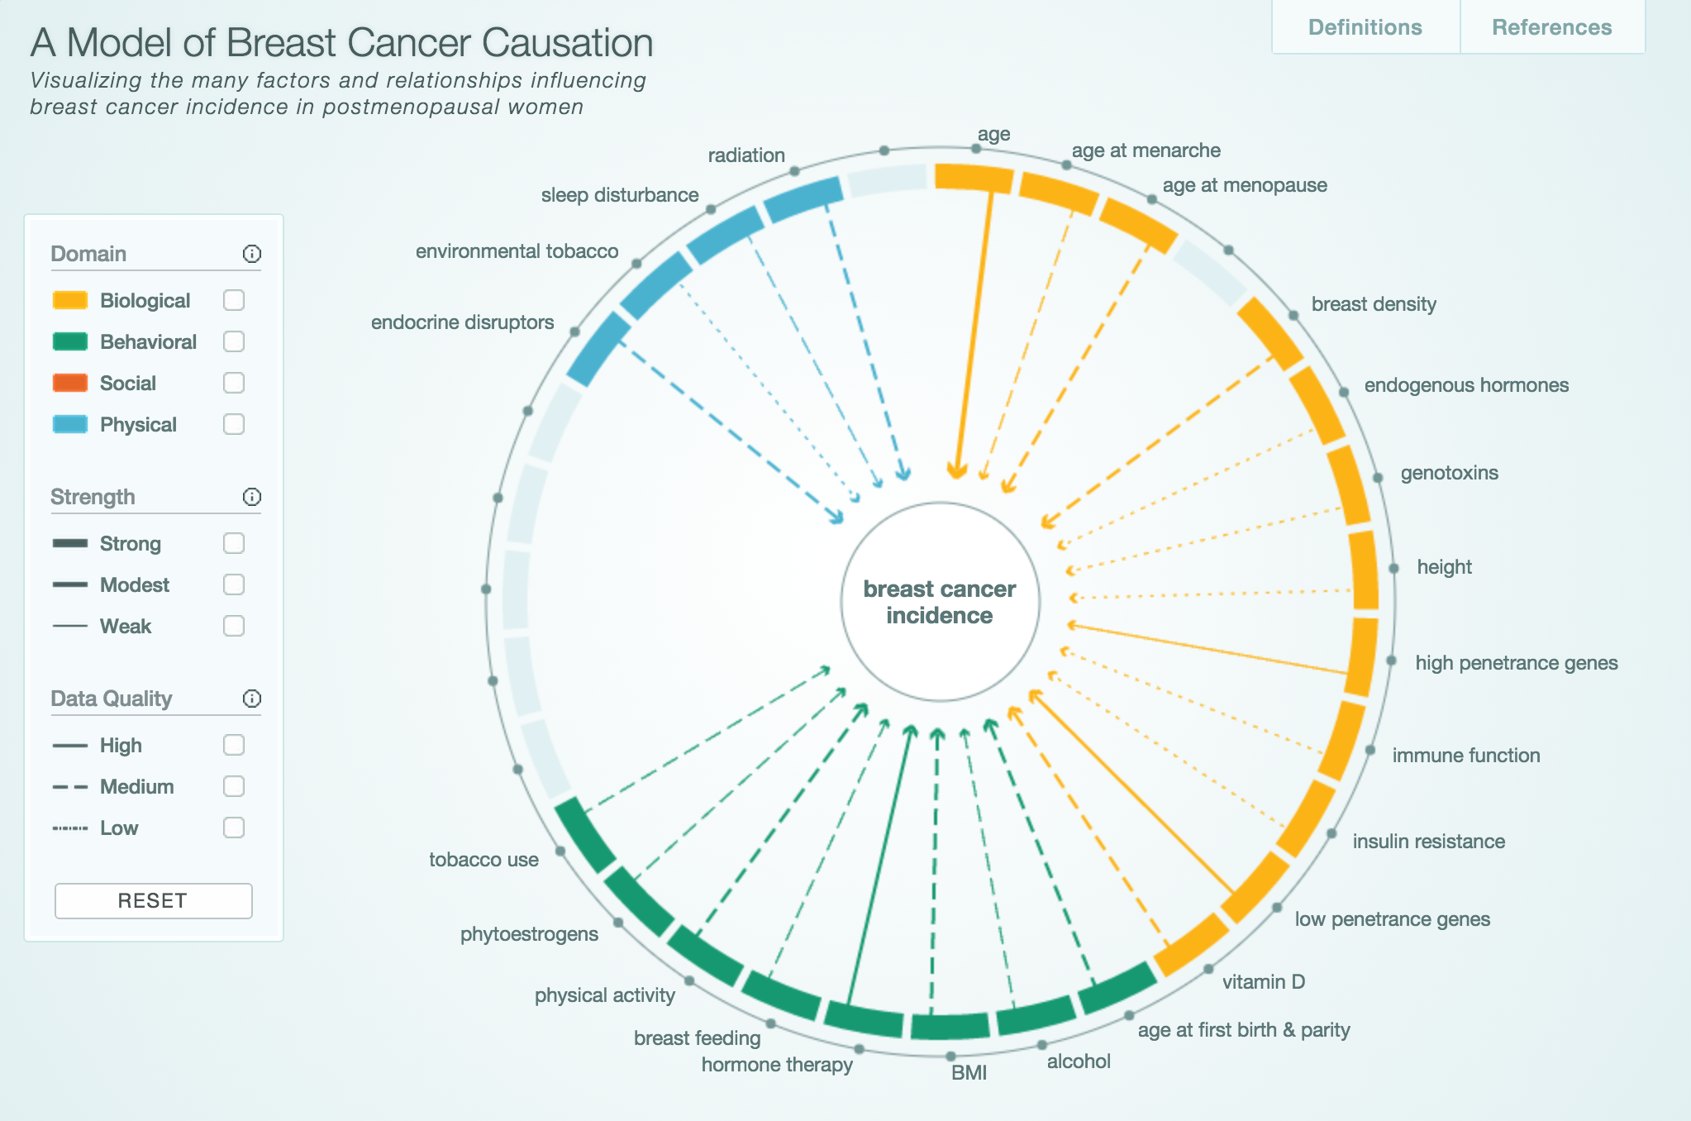
http://www.cabreastcancer.org/causes/#
Notes:
Much more explicit causality.

Slide 49


Slide 50
Design Challenge
In groups of 3 create an interactive slideshow narrative using the views provided.
15 mins. Sketch a storyboard of points considering various orderings and deciding on one ordering. (You can sketch a view if you need it but it’s not on print-out)
15 mins. Write a story around these by writing the “glue” the connects (comparisons, explanations, context). Use your imagination to consider animations or other transitions and describe these as “stage instructions”
15 mins. Do additional research to fill in gaps in knowledge, or provide an opening / closing context. Practice telling the story.
30 mins. Final presentation of story (6 teams x 5 teams each).

Slide 51
Questions?

